Slide 1
VA AUC correlations, yearly change, and monocular vs. binocular comparison
Adam Shah

Slide 2
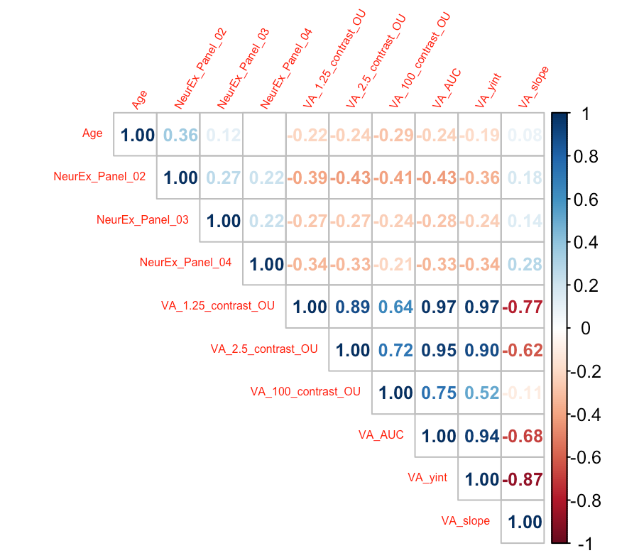
Corrected correlation matrix with all VA outcomes, age, and NeurEx

Slide 3
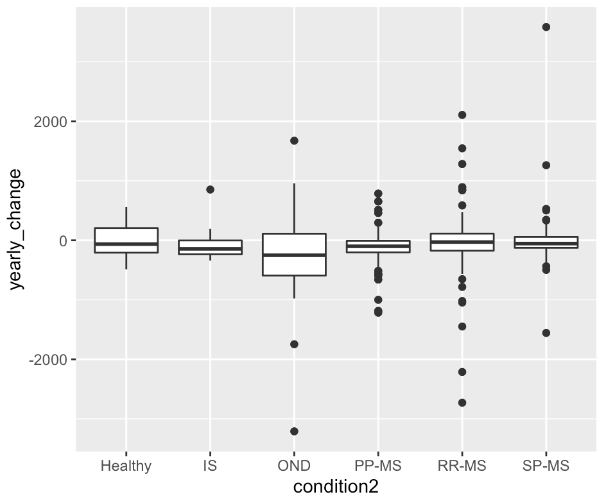
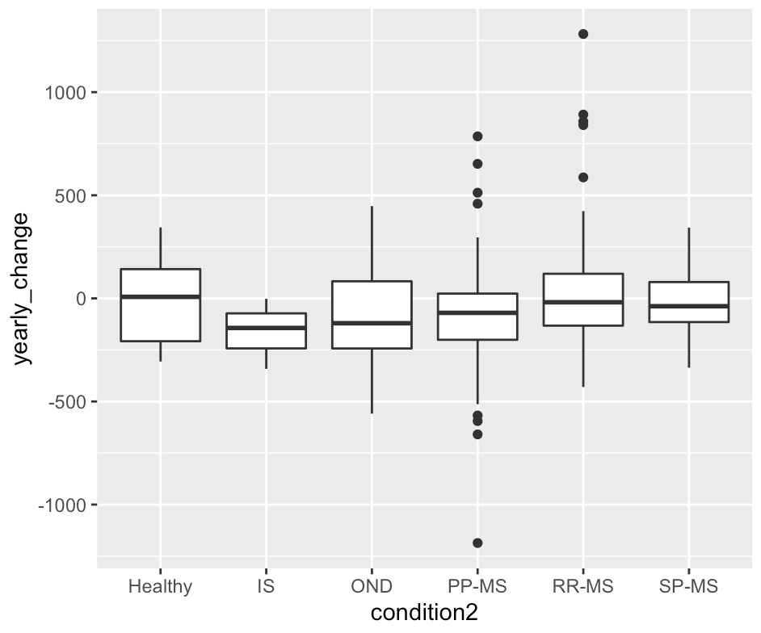
Yearly change by diagnosis
Patients with at least 2 timepoints
Patients with at least 3 timepoints

Slide 4
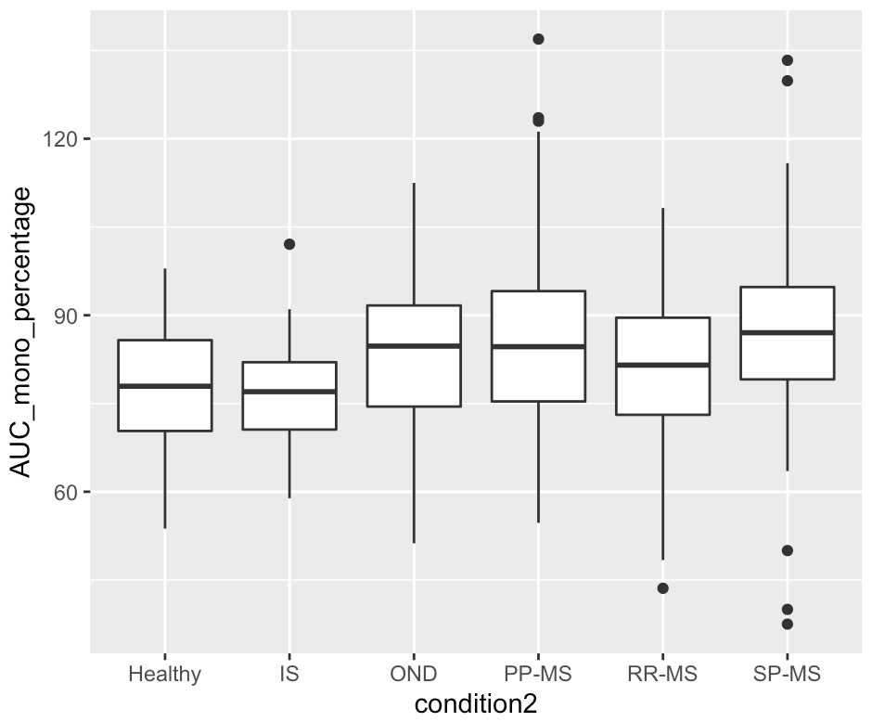
Percentage comparing better monocular eye to binocular vision
*Higher percentages mean higher
monocular/binocular ratio, 100%
means binocular and better
monocular AUC were equal

